Slide 1
Lecture 6: Conditioning and Condition Numbers
NLA Chapters 12

Slide 2
What’s next
Two fundamental issues of numerical analysis:
Conditioning: perturbation behavior of a mathematical problem (in general, the difficulty of the problem itself to solve numerically!)
Stability: perturbation behavior of an algorithm to solve that problem on a computer (the quality of the numerical algorithm)
What is perturbation? Why care?
Perturbation behavior is the sensitivity of the output to the small perturbations in the input.
I.e., if I change the input by a certain amount, how much my output is going to change?

Slide 3
Why care about perturbation?
Because reality is harsh ☺
Okay, because pretty much anything we do numerically on a computer involves some kind of error.

Slide 4
Error is Life
Mathematics vs. Numerical Analysis (Richard W. Hamming):
Mathematics routinely work with infinite representations for numbers and process (real numbers, limits, etc)
Numerical Analysis: digital computer can only model finite representations.
Finite representation of numbers: roundoff error
Finite representation of processes: truncation error
The difference is rather fundamental:
Numerical computations are “approximate computing”
Mathematical equivalent computations lead to very different numerical computations: numerical analysis
Numerical computations often feel more “art” than science.

Slide 5
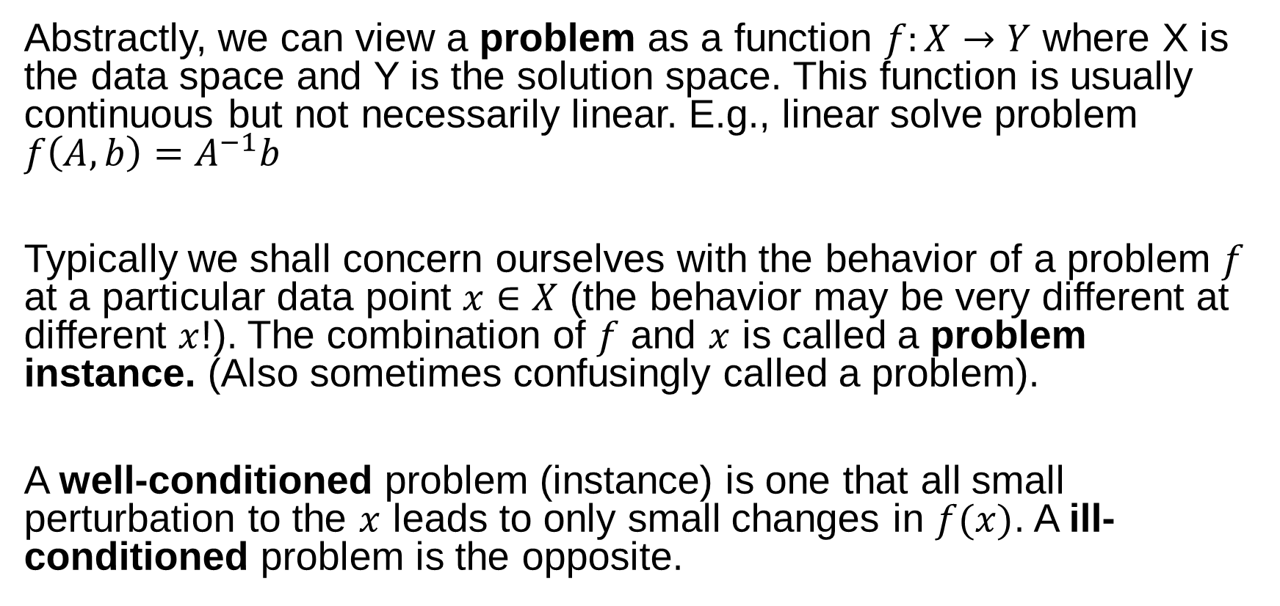
Condition of a Problem
Abstractly, we can view a problem as a function $f:X→Y$ where X is the data space and Y is the solution space. This function is usually continuous but not necessarily linear. E.g., linear solve problem $f\left(A,b\right)=A^{−1}b$
Typically we shall concern ourselves with the behavior of a problem $f$ at a particular data point $x∈X$ (the behavior may be very different at different $x$!). The combination of $f$ and $x$ is called a problem instance. (Also sometimes confusingly called a problem).
A well-conditioned problem (instance) is one that all small perturbation to the $x$ leads to only small changes in $f(x)$. A ill-conditioned problem is the opposite.

Slide 6
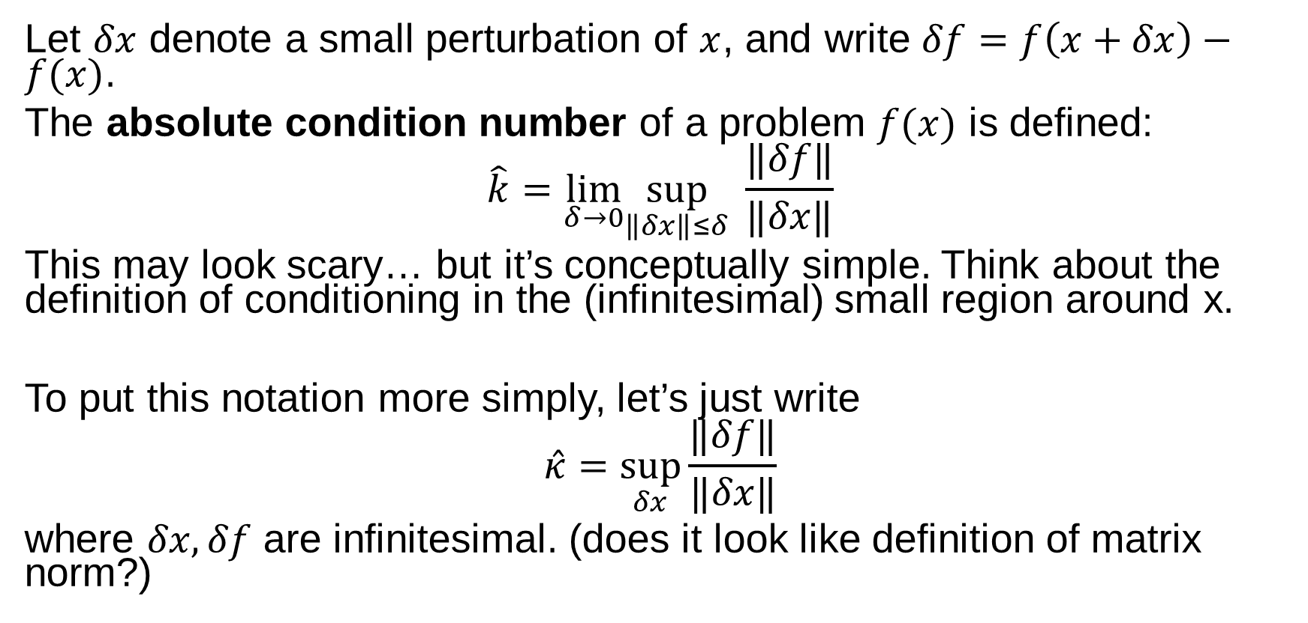
Quantification of Conditioning
Let $δx$ denote a small perturbation of $x$, and write $δf=f\left(x+δx\right)−f(x)$.
The absolute condition number of a problem $f(x)$ is defined:
$$\hat{k}=\lim_{δ→0}\sup_{\left\|δx\right\|≤δ} \frac{‖δf‖}{‖δx‖}$$
This may look scary… but it’s conceptually simple. Think about the definition of conditioning in the (infinitesimal) small region around x.
To put this notation more simply, let’s just write
$$\hat{κ}=\sup_{δx}\frac{‖δf‖}{‖δx‖}$$
where $δx,δf$ are infinitesimal. (does it look like definition of matrix norm?)

Slide 7
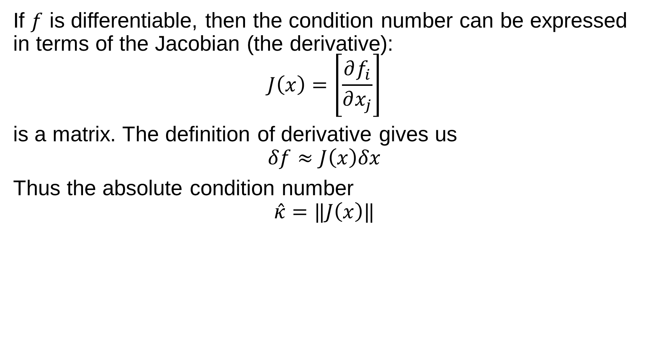
If $f$ is differentiable, then the condition number can be expressed in terms of the Jacobian (the derivative):
$$J\left(x\right)=\left.\left[\frac{∂f_{i}}{∂x_{j}}\right.\right]$$
is a matrix. The definition of derivative gives us
$$δf≈J\left(x\right)δx$$
Thus the absolute condition number
$$\hat{κ}=‖J\left(x\right)‖$$

Slide 8
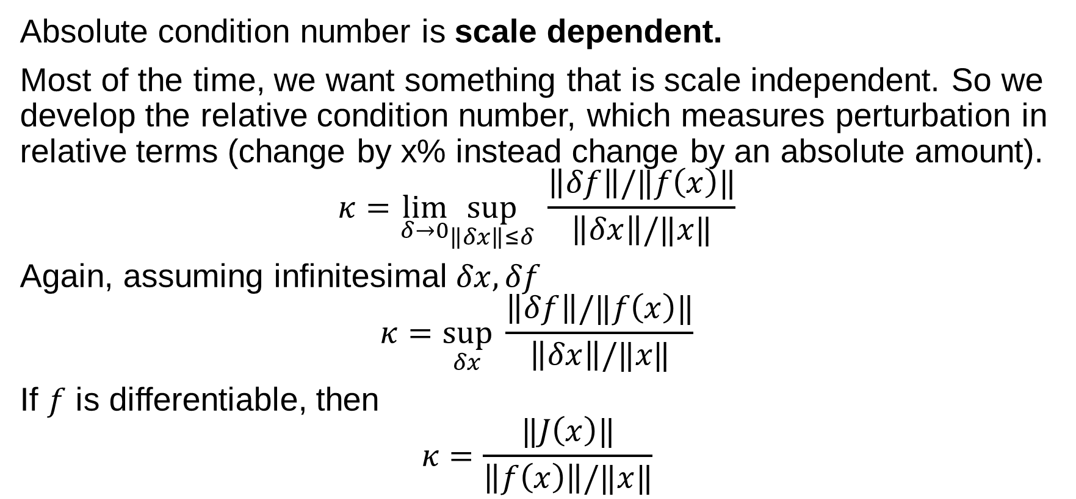
Relative Condition Number
Absolute condition number is scale dependent.
Most of the time, we want something that is scale independent. So we develop the relative condition number, which measures perturbation in relative terms (change by x% instead change by an absolute amount).
$$κ=\lim_{δ→0}\sup_{\left\|δx\right\|≤δ} \frac{\left\|δf\right\|/‖f\left(x\right)‖}{\left\|δx\right\|/‖x‖}$$
Again, assuming infinitesimal $δx, δf$
$$κ=\sup_{δx} \frac{\left\|δf\right\|/‖f\left(x\right)‖}{\left\|δx\right\|/‖x‖}$$
If $f$ is differentiable, then
$$κ=\frac{‖J\left(x\right)‖}{\left\|f\left(x\right)\right\|/‖x‖}$$

Slide 9
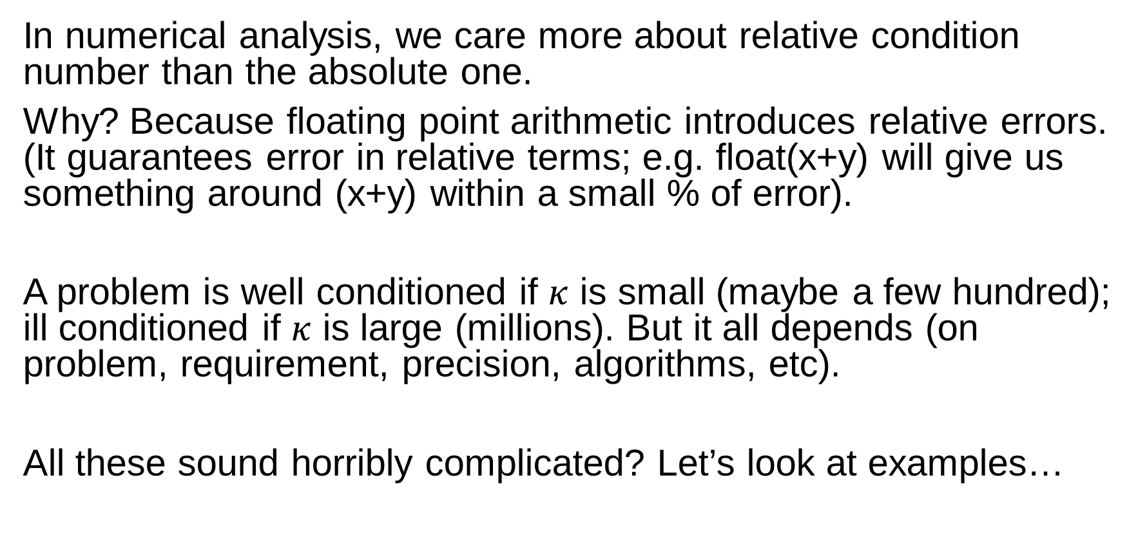
Relative vs. Absolute
In numerical analysis, we care more about relative condition number than the absolute one.
Why? Because floating point arithmetic introduces relative errors. (It guarantees error in relative terms; e.g. float(x+y) will give us something around (x+y) within a small % of error).
A problem is well conditioned if $κ$ is small (maybe a few hundred); ill conditioned if $κ$ is large (millions). But it all depends (on problem, requirement, precision, algorithms, etc).
All these sound horribly complicated? Let’s look at examples…

Slide 10
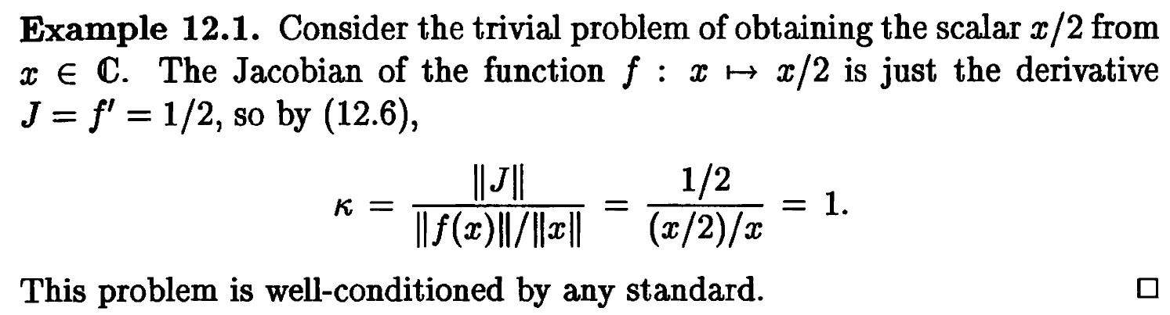
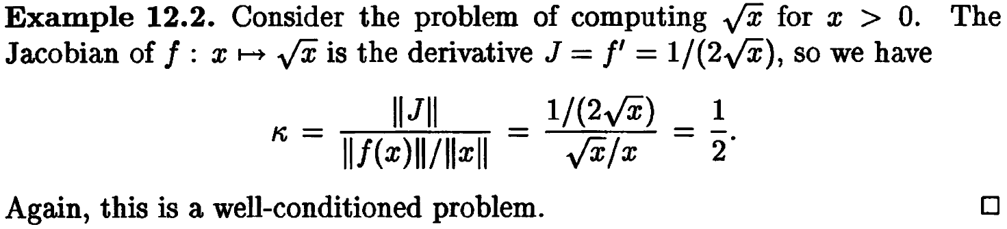
Examples

Slide 11
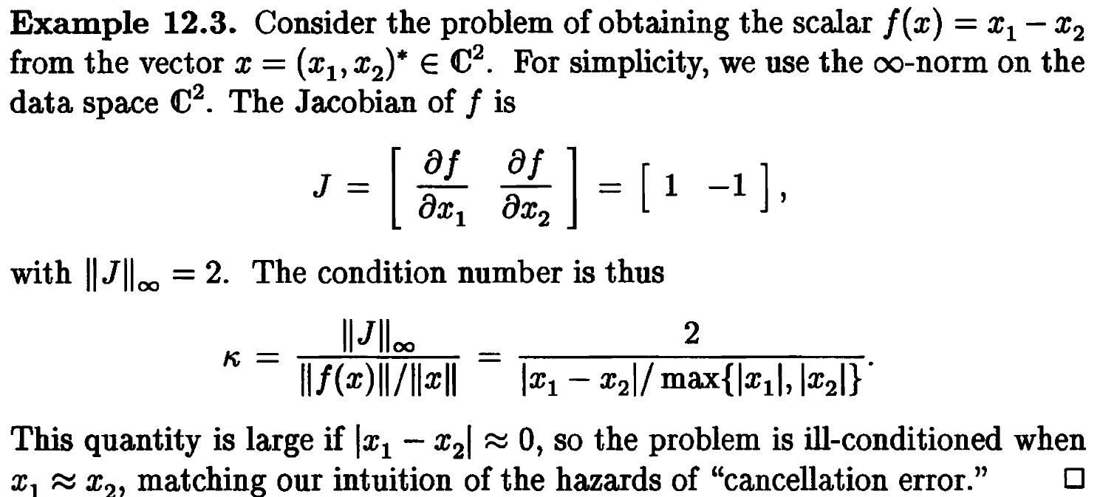
An ill-conditioned example

Slide 12
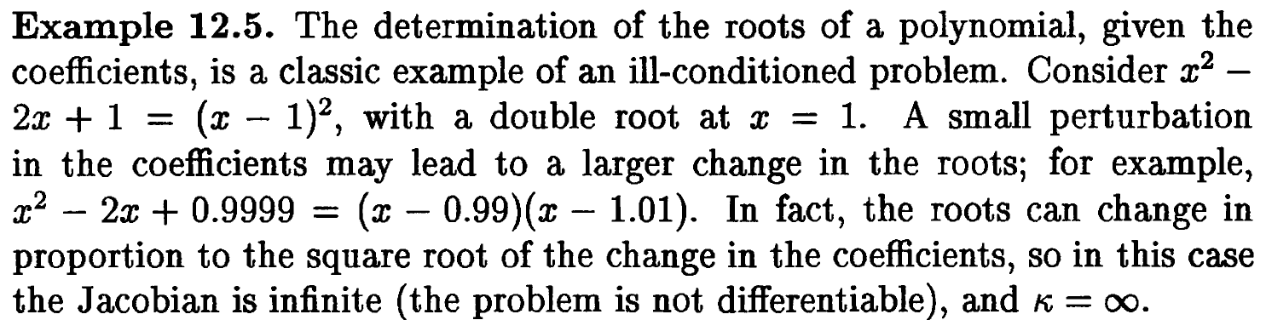
ill-conditioned problem: Polynomial root finding.

Slide 13
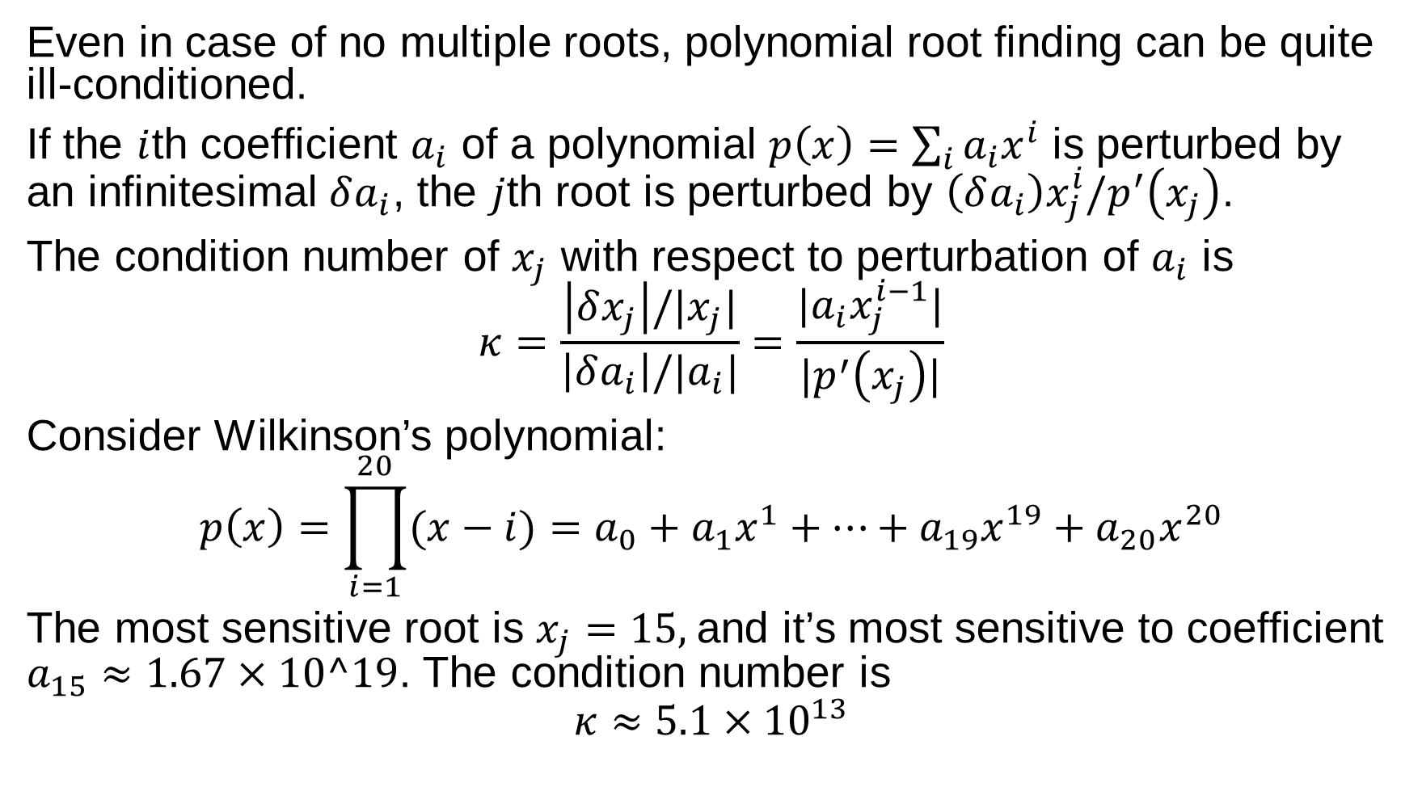
Even in case of no multiple roots, polynomial root finding can be quite ill-conditioned.
If the $i$th coefficient $a_{i}$ of a polynomial $p\left(x\right)=\sum_{i}{a_{i}x^{i}}$ is perturbed by an infinitesimal $δa_{i}$, the $j$th root is perturbed by $\left(δa_{i}\right)x_{j}^{i}/p^{′}\left(x_{j}\right)$.
The condition number of $x_{j}$ with respect to perturbation of $a_{i}$ is
$$κ=\frac{\left|δx_{j}\right|/|x_{j}|}{\left|δa_{i}\right|/|a_{i}|}=\frac{|a_{i}x_{j}^{i−1}|}{|p^{′}\left(x_{j}\right)|}$$
Consider Wilkinson’s polynomial:
$$p\left(x\right)=\prod_{i=1}^{20}{(x−i)}=a_{0}+a_{1}x^{1}+…+a_{19}x^{19}+a_{20}x^{20}$$
The most sensitive root is $x_{j}=15,$and it’s most sensitive to coefficient $a_{15}≈1.67×10^19$. The condition number is
$$κ≈5.1×{10}^{13}$$

Slide 14
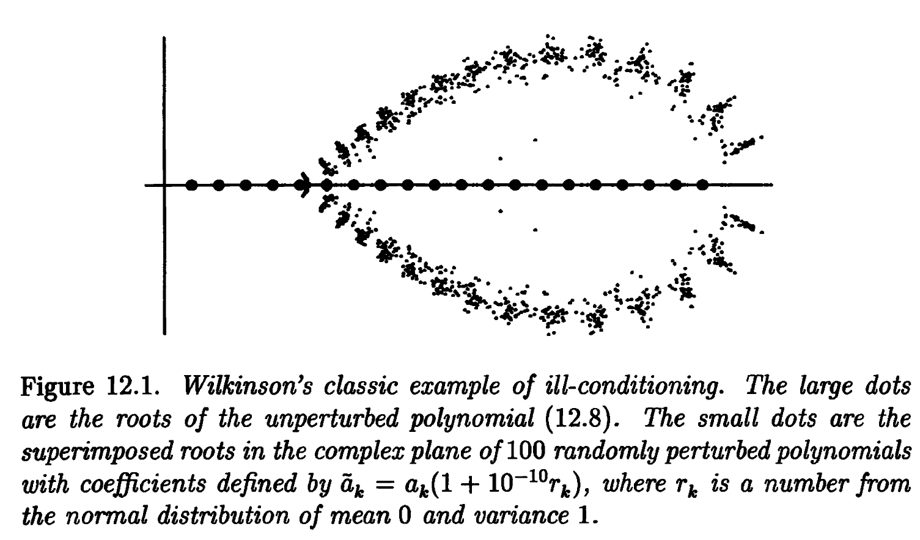

Slide 15
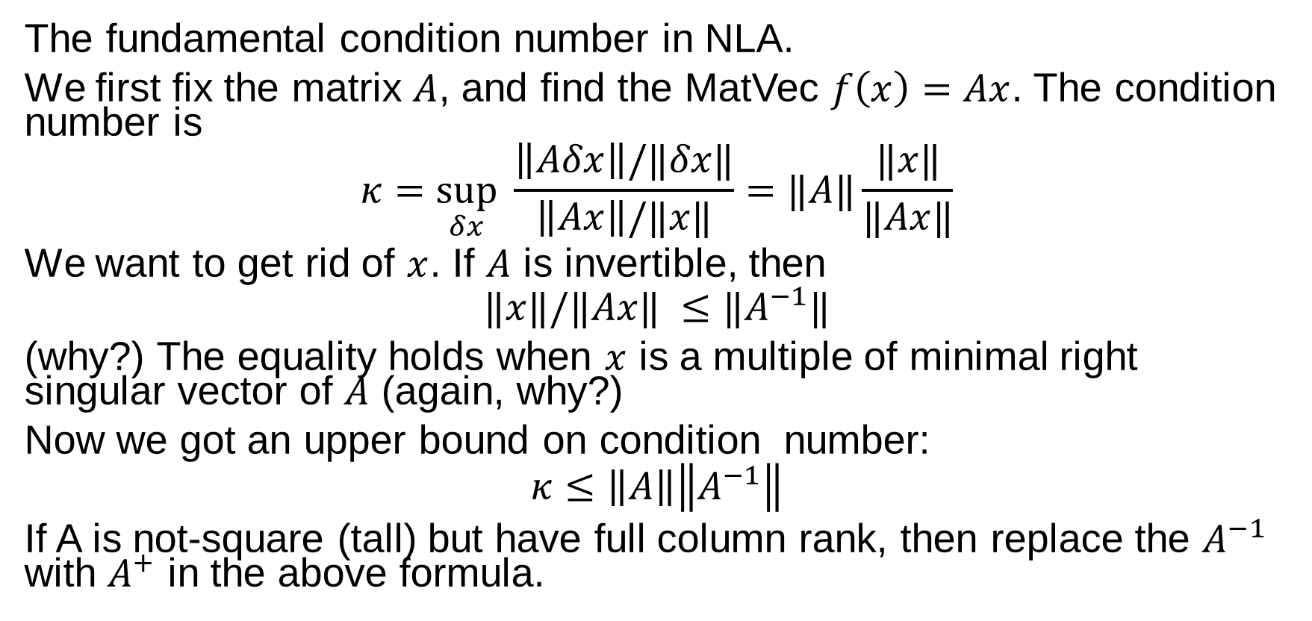
Condition of MatVec Mul
The fundamental condition number in NLA.
We first fix the matrix $A$, and find the MatVec $f\left(x\right)=Ax$. The condition number is
$$κ=\sup_{δx} \frac{\left\|Aδx\right\|/‖δx‖}{\left\|Ax\right\|/‖x‖}=‖A‖\frac{‖x‖}{‖Ax‖}$$
We want to get rid of $x$. If $A$ is invertible, then
$$‖x‖/‖Ax‖ ≤‖A^{−1}‖$$
(why?) The equality holds when $x$ is a multiple of minimal right singular vector of $A$ (again, why?)
Now we got an upper bound on condition number:
$$κ≤\left\|A\right\|\left\|A^{−1}\right\|$$
If A is not-square (tall) but have full column rank, then replace the $A^{−1}$ with $A^{+}$ in the above formula.

Slide 16
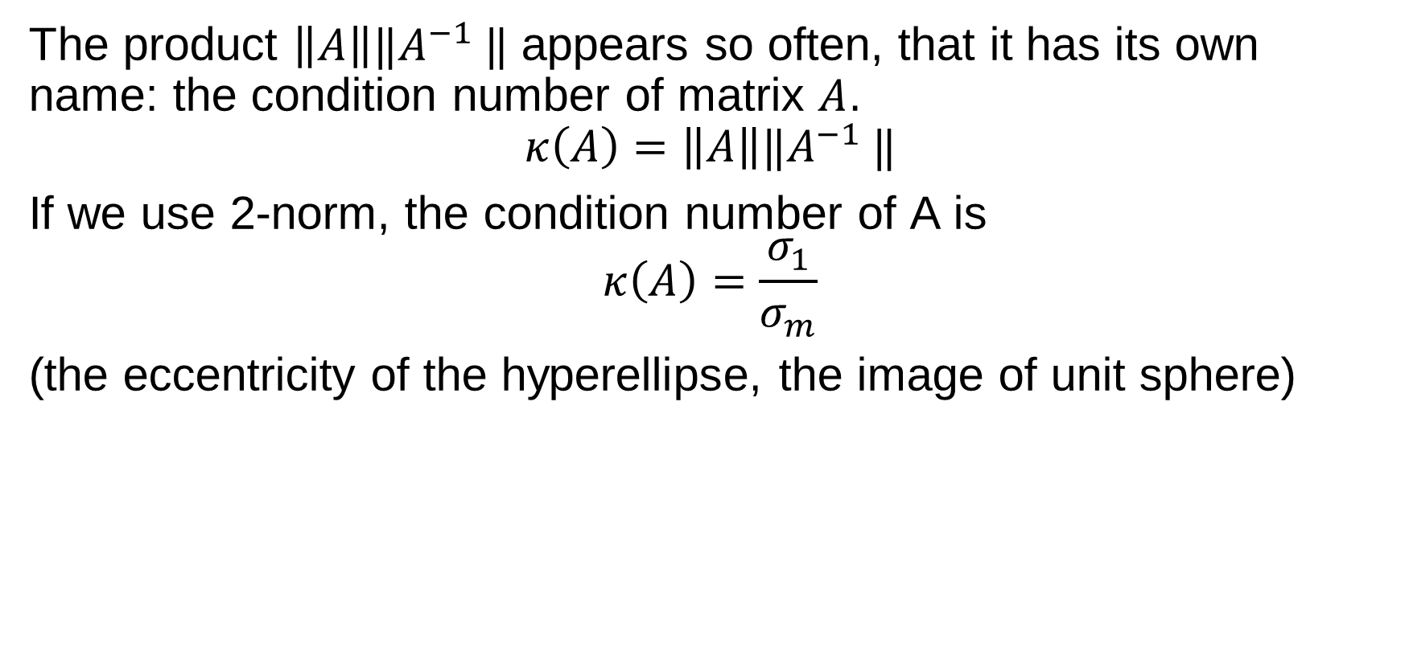
Condition number of a matrix
The product $\left\|A\right\|‖A^{−1} ‖$ appears so often, that it has its own name: the condition number of matrix $A$.
$$κ\left(A\right)=\left\|A\right\|‖A^{−1} ‖$$
If we use 2-norm, the condition number of A is
$$κ\left(A\right)=\frac{σ_{1}}{σ_{m}}$$
(the eccentricity of the hyperellipse, the image of unit sphere)

Slide 17
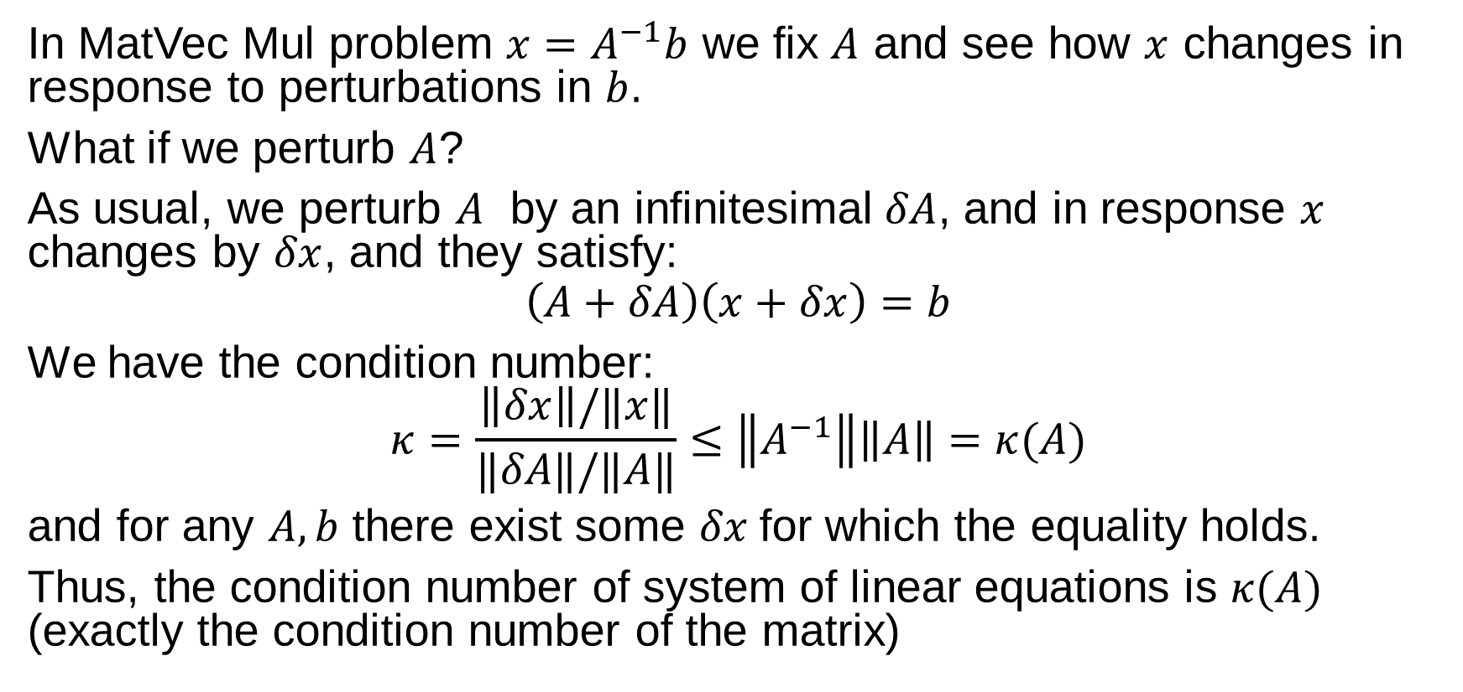
Condition of a system of linear equations
In MatVec Mul problem $x=A^{−1}b$ we fix $A$ and see how $x$ changes in response to perturbations in $b$.
What if we perturb $A$?
As usual, we perturb $A$ by an infinitesimal $δA$, and in response $x$ changes by $δx$, and they satisfy:
$$\left(A+δA\right)\left(x+δx\right)=b$$
We have the condition number:
$$κ=\frac{\left\|δx\right\|/‖x‖}{‖δA‖/‖A‖}≤\left\|A^{−1}\right\|\left\|A\right\|=κ(A)$$
and for any $A,b$ there exist some $δx$for which the equality holds.
Thus, the condition number of system of linear equations is $κ(A)$ (exactly the condition number of the matrix)

Slide 18
Floating Point Arithmetic
NLA Chapter 13

Slide 19
Finite representation of real numbers
Digital computer use finite number of bits to represent real numbers. This has two implications:
The representable number is cannot be arbitrarily large or small
There are gaps between two adjacent representable numbers.
All modern computers (nowadays there are reemergence of customized floating point system or even fixed point system, specialized for AI) use IEEE floating point format to represent numbers and do arithmetic.

Slide 20
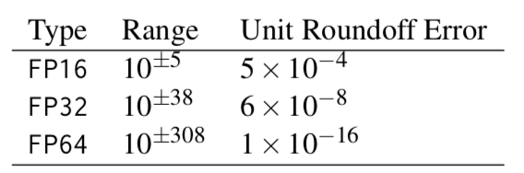
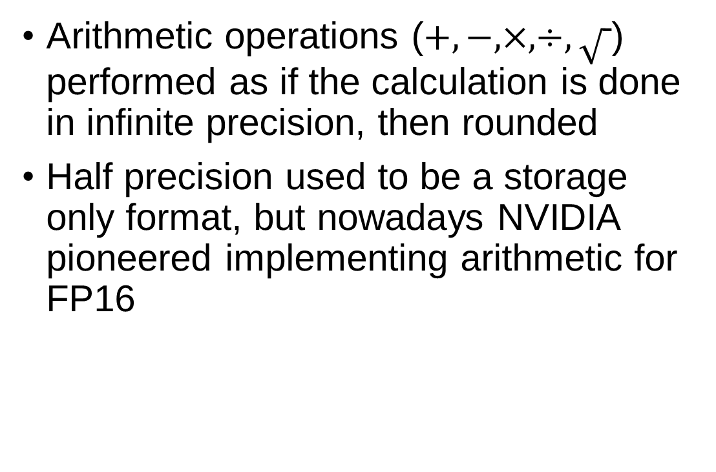
IEEE 754
Arithmetic operations ($+,−,×,÷,\sqrt{ }$) performed as if the calculation is done in infinite precision, then rounded
Half precision used to be a storage only format, but nowadays NVIDIA pioneered implementing arithmetic for FP16

Slide 21
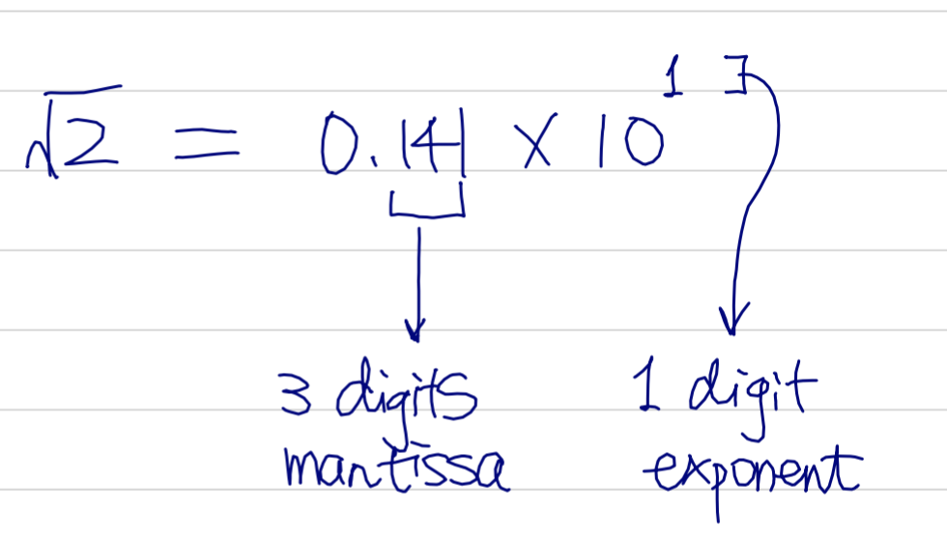
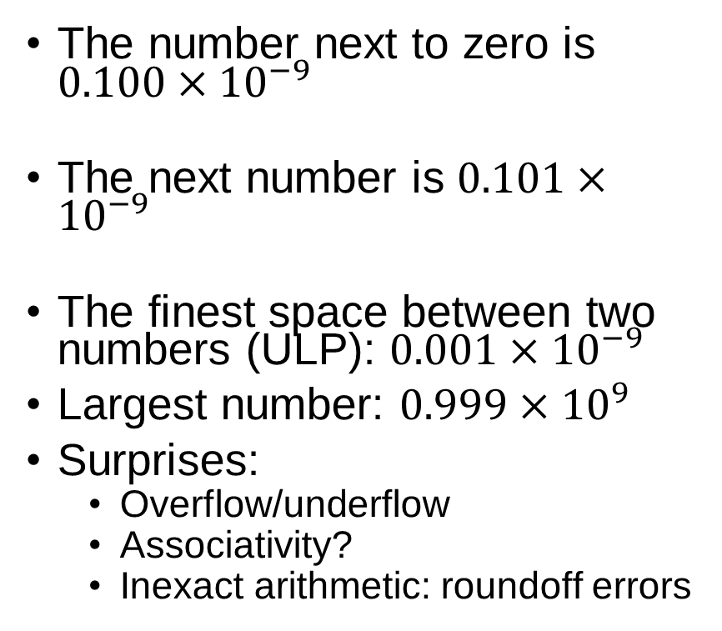
A Toy 3-digit Decimal Floating Point System
The number next to zero is $0.100×{10}^{−9}$
The next number is $0.101×{10}^{−9}$
The finest space between two numbers (ULP): $0.001×{10}^{−9}$
Largest number: $0.999×{10}^{9}$
Surprises:
Overflow/underflow
Associativity?
Inexact arithmetic: roundoff errors

Slide 22
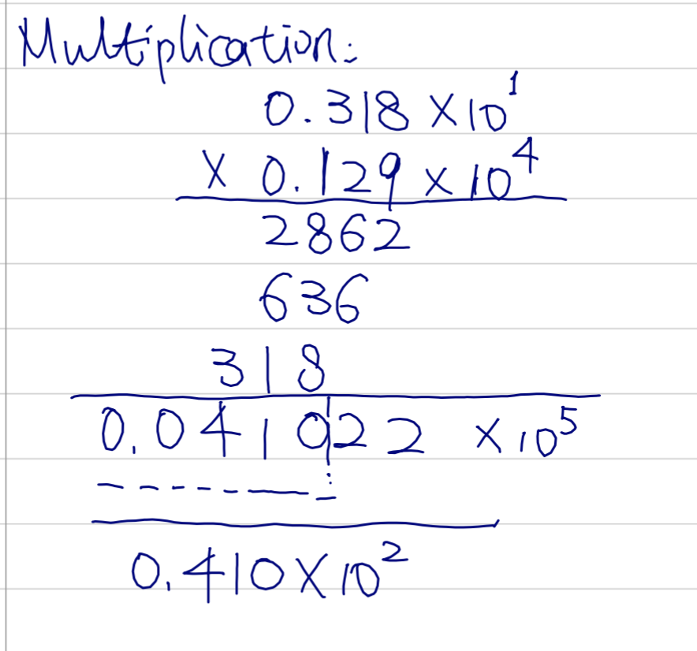
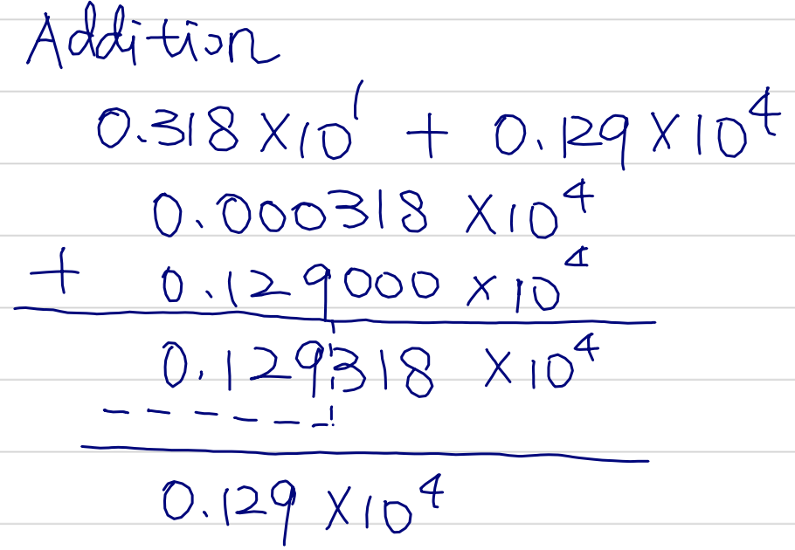
Rounding

Slide 23
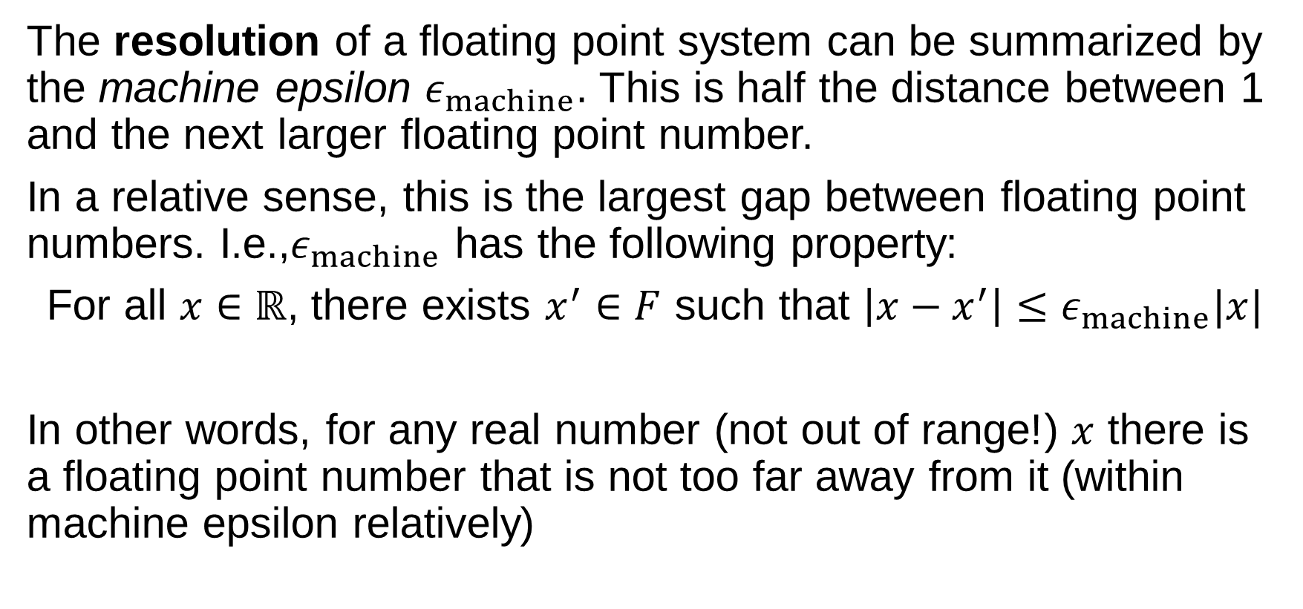
Machine Epsilon
The resolution of a floating point system can be summarized by the machine epsilon $ε_{machine}$. This is half the distance between 1 and the next larger floating point number.
In a relative sense, this is the largest gap between floating point numbers. I.e.,$ε_{machine}$ has the following property:
For all $x∈ℝ$, there exists $x^{′}∈F$ such that $\left|x−x^{′}\right|≤ε_{machine}|x|$
In other words, for any real number (not out of range!) $x$ there is a floating point number that is not too far away from it (within machine epsilon relatively)

Slide 24
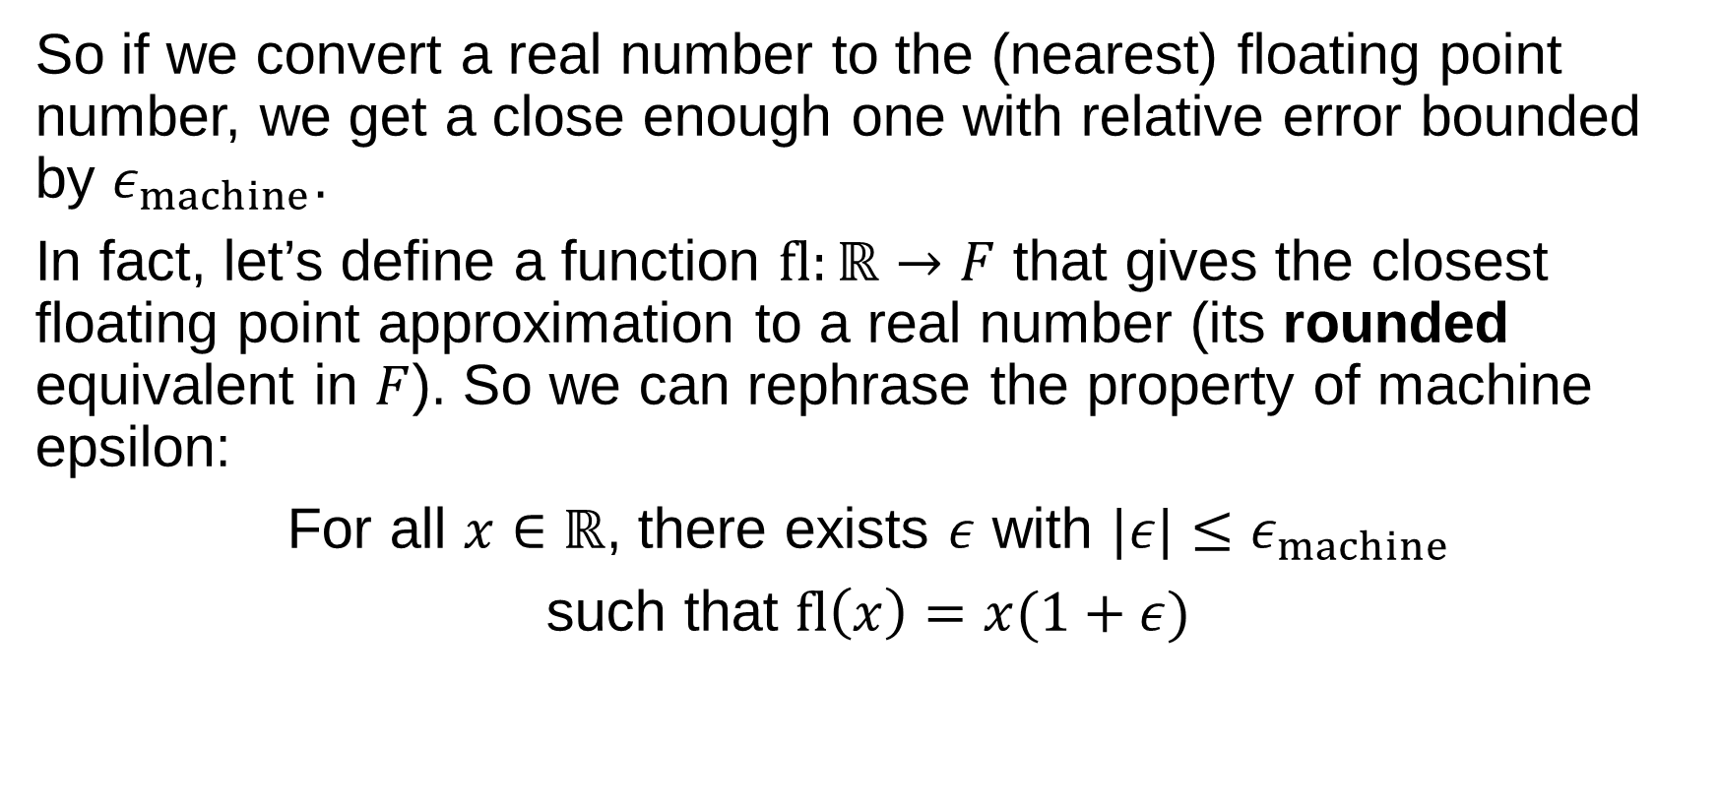
So if we convert a real number to the (nearest) floating point number, we get a close enough one with relative error bounded by $ε_{machine}$.
In fact, let’s define a function $fl:ℝ→F$ that gives the closest floating point approximation to a real number (its rounded equivalent in $F$). So we can rephrase the property of machine epsilon:
For all $x∈ℝ$, there exists $ε$ with $|ε|≤ε_{machine}$
such that $fl\left(x\right)=x(1+ε)$

Slide 25
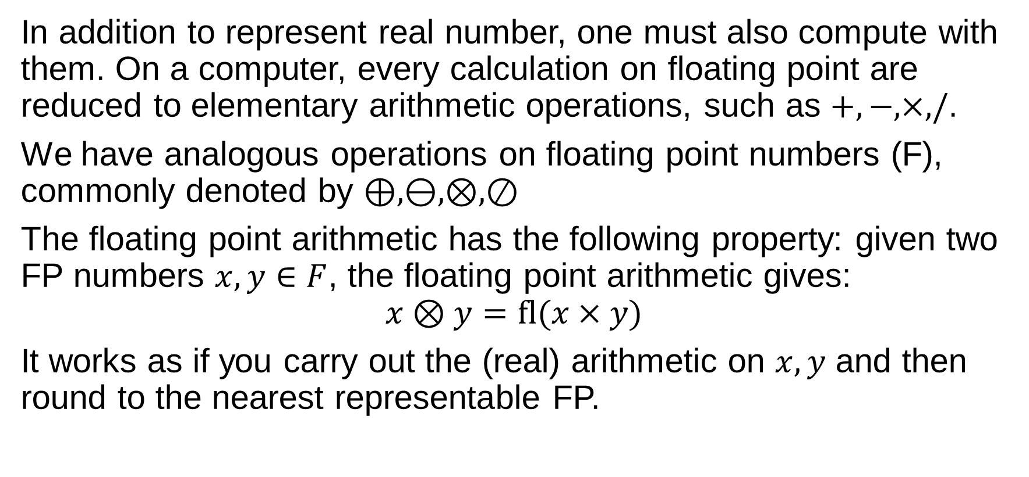
Floating Point Arithmetic
In addition to represent real number, one must also compute with them. On a computer, every calculation on floating point are reduced to elementary arithmetic operations, such as $+,−,×,/$.
We have analogous operations on floating point numbers (F), commonly denoted by $⊕,⊖,⊗,⊘$
The floating point arithmetic has the following property: given two FP numbers $x,y∈F$, the floating point arithmetic gives:
$$x⊗y=fl(x×y)$$
It works as if you carry out the (real) arithmetic on $x,y$ and then round to the nearest representable FP.

Slide 26
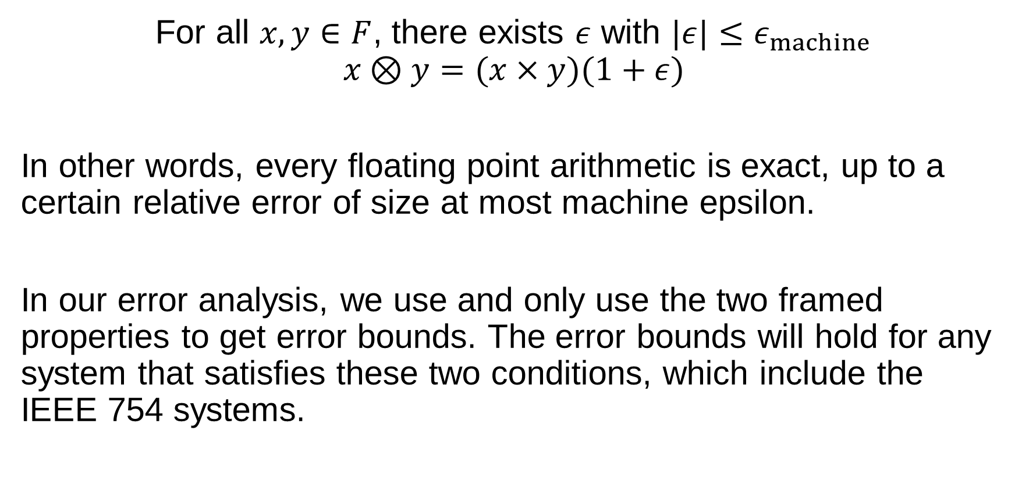
Fundamental Axiom of FP Arithmetic
For all $x,y∈F$, there exists $ε$ with $|ε|≤ε_{machine}$
$$x⊗y=(x×y)(1+ε)$$
In other words, every floating point arithmetic is exact, up to a certain relative error of size at most machine epsilon.
In our error analysis, we use and only use the two framed properties to get error bounds. The error bounds will hold for any system that satisfies these two conditions, which include the IEEE 754 systems.

Slide 27
Stability
NLA Chapter 14

Slide 28
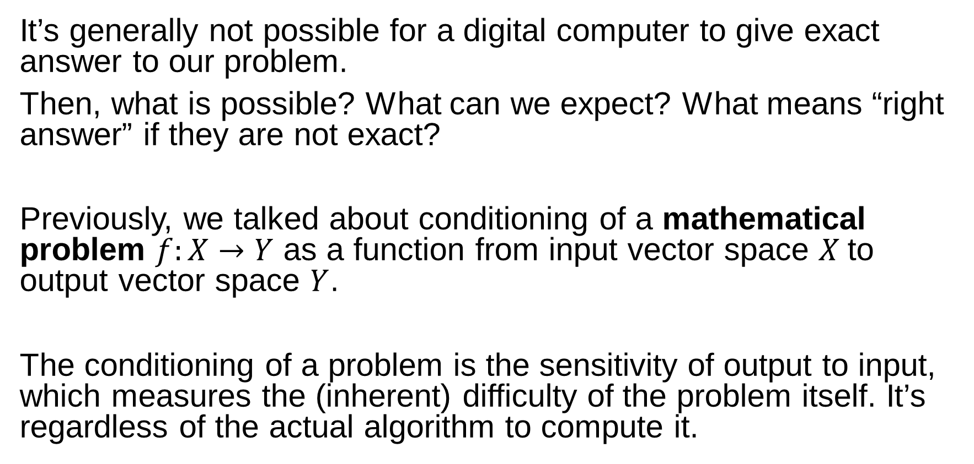
Stability
It’s generally not possible for a digital computer to give exact answer to our problem.
Then, what is possible? What can we expect? What means “right answer” if they are not exact?
Previously, we talked about conditioning of a mathematical problem $f:X→Y$ as a function from input vector space $X$to output vector space $Y$.
The conditioning of a problem is the sensitivity of output to input, which measures the (inherent) difficulty of the problem itself. It’s regardless of the actual algorithm to compute it.

Slide 29
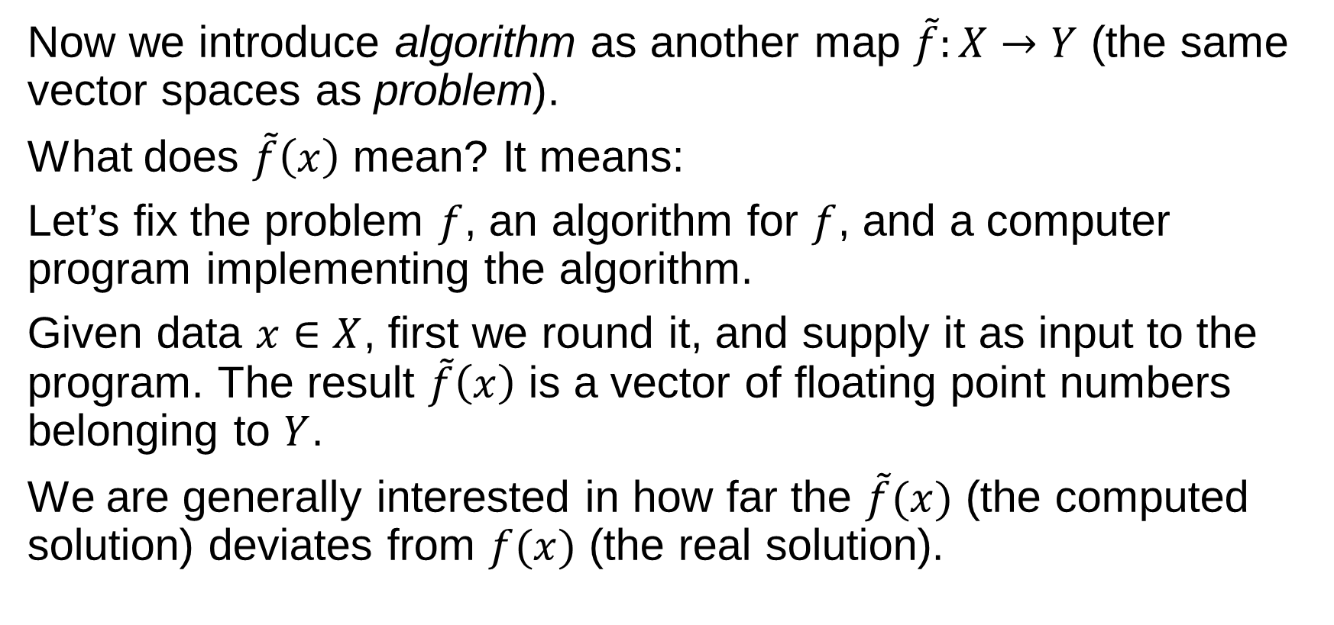
Numerical Algorithms
Now we introduce algorithm as another map $\tilde{f}:X→Y$ (the same vector spaces as problem).
What does $\tilde{f}\left(x\right)$ mean? It means:
Let’s fix the problem $f$, an algorithm for $f$, and a computer program implementing the algorithm.
Given data $x∈X$, first we round it, and supply it as input to the program. The result $\tilde{f}\left(x\right)$ is a vector of floating point numbers belonging to $Y$.
We are generally interested in how far the $\tilde{f}(x)$ (the computed solution) deviates from $f(x)$ (the real solution).

Slide 30
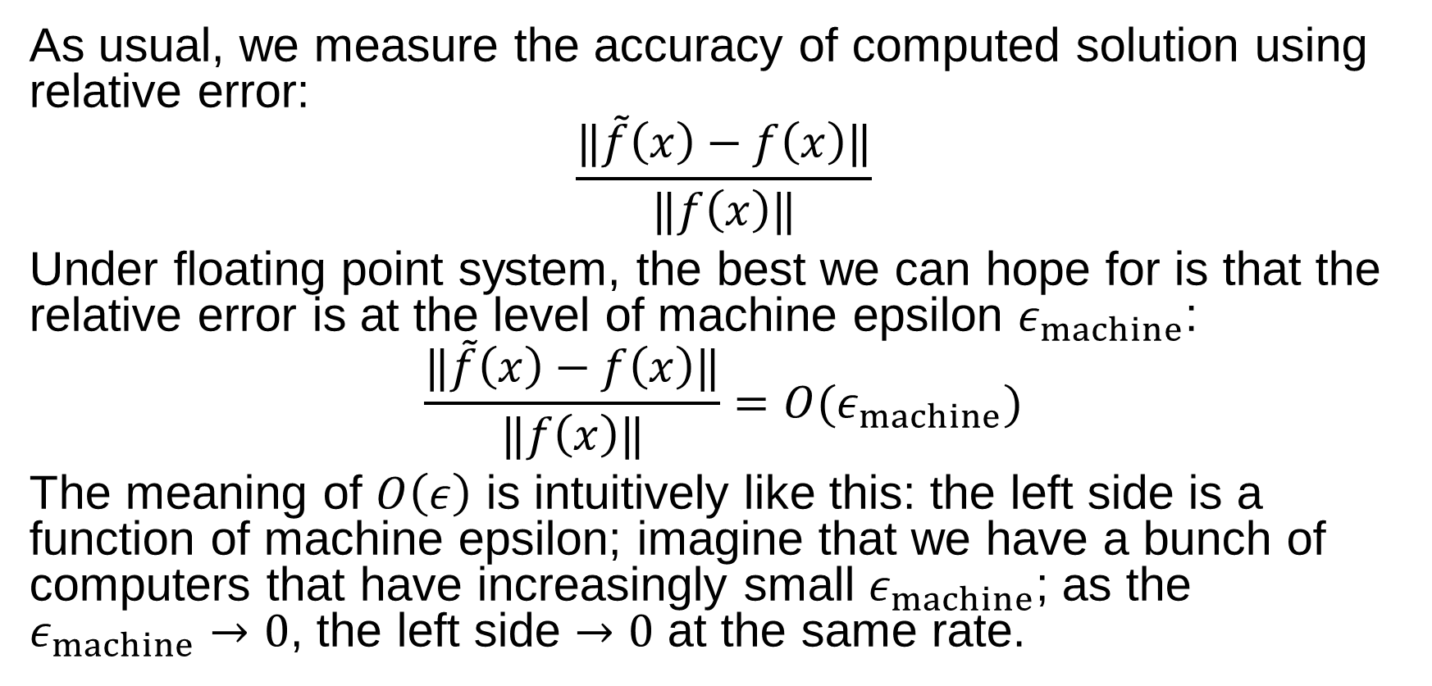
Accuracy
As usual, we measure the accuracy of computed solution using relative error:
$$\frac{‖\tilde{f}\left(x\right)−f\left(x\right)‖}{‖f\left(x\right)‖}$$
Under floating point system, the best we can hope for is that the relative error is at the level of machine epsilon $ε_{machine}$:
$$\frac{‖\tilde{f}\left(x\right)−f\left(x\right)‖}{‖f\left(x\right)‖}=O(ε_{machine})$$
The meaning of $O\left(ε\right)$ is intuitively like this: the left side is a function of machine epsilon; imagine that we have a bunch of computers that have increasingly small $ε_{machine}$; as the $ε_{machine}→0$, the left side $→0$ at the same rate.

Slide 31
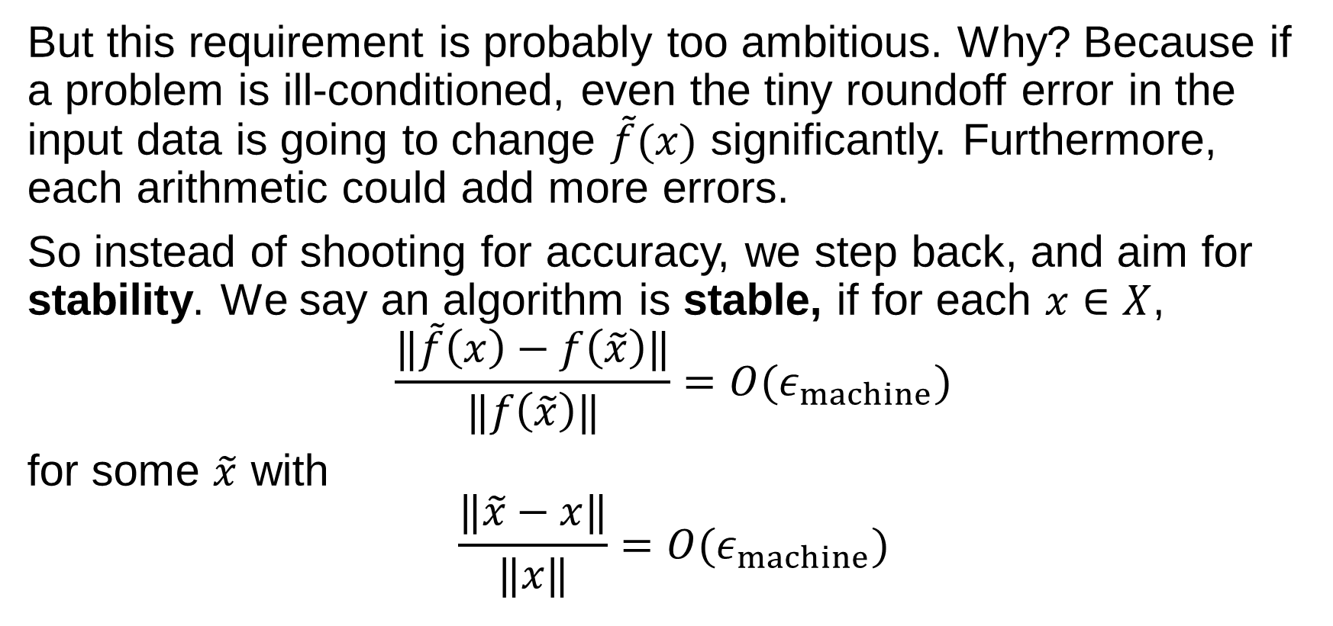
Stability
But this requirement is probably too ambitious. Why? Because if a problem is ill-conditioned, even the tiny roundoff error in the input data is going to change $\tilde{f}(x)$ significantly. Furthermore, each arithmetic could add more errors.
So instead of shooting for accuracy, we step back, and aim for stability. We say an algorithm is stable, if for each $x∈X$,
$$\frac{‖\tilde{f}\left(x\right)−f\left(\tilde{x}\right)‖}{‖f\left(\tilde{x}\right)‖}=O(ε_{machine})$$
for some $\tilde{x}$ with
$$\frac{‖\tilde{x}−x‖}{‖x‖}=O(ε_{machine})$$

Slide 32
Stability
In English, stability means:
A stable algorithm gives nearly the right answer,
to nearly the right question.
We solve a slightly wrong question, with slightly wrong answer.
This is a counterintuitive way to say stability… but it makes a lot of sense. Why? Because it casts error back to the perturbation to the input data, thus solved our problem with conditioning.
Stability is a reasonable requirement for an algorithm.

Slide 33
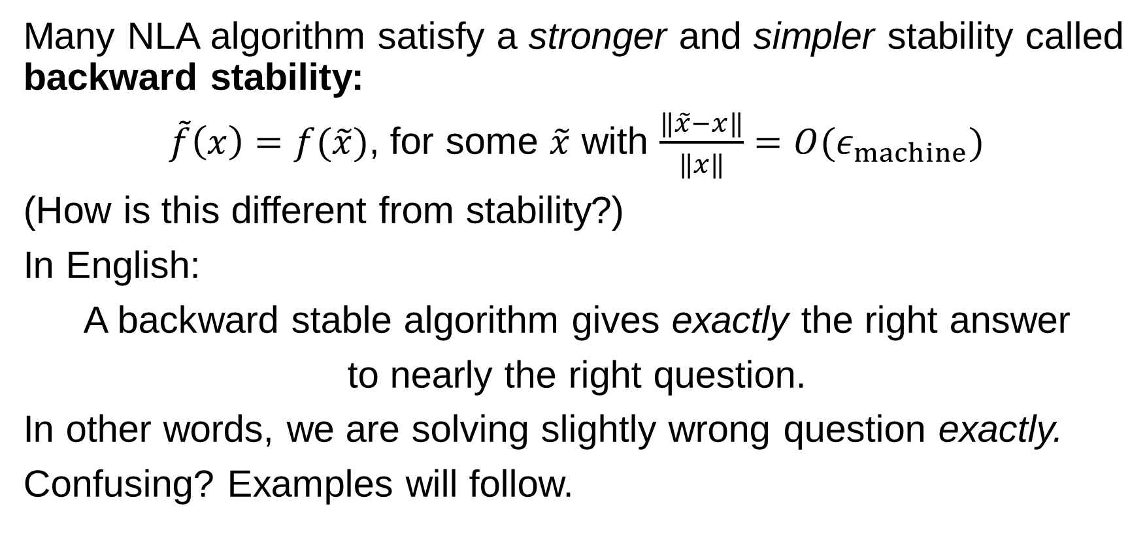
Backward Stability
Many NLA algorithm satisfy a stronger and simpler stability called backward stability:
$\tilde{f}\left(x\right)=f(\tilde{x})$, for some $\tilde{x}$ with $\frac{‖\tilde{x}−x‖}{‖x‖}=O(ε_{machine})$
(How is this different from stability?)
In English:
A backward stable algorithm gives exactly the right answer
to nearly the right question.
In other words, we are solving slightly wrong question exactly.
Confusing? Examples will follow.

Slide 34
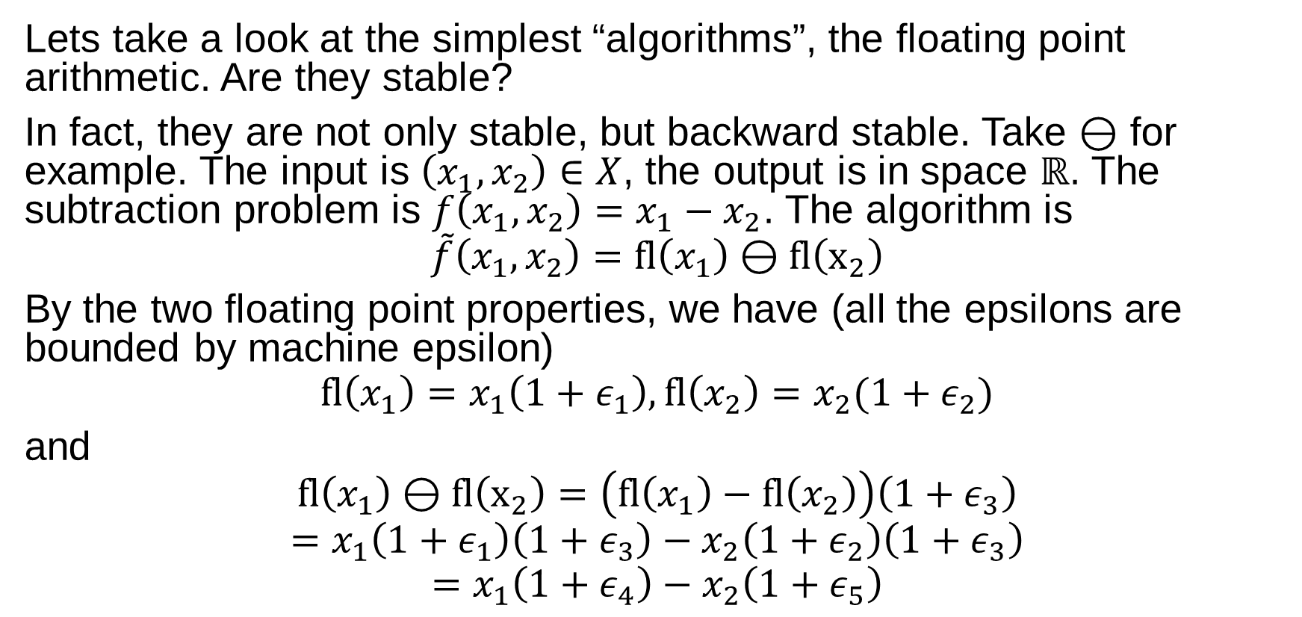
Stability Examples
Lets take a look at the simplest “algorithms”, the floating point arithmetic. Are they stable?
In fact, they are not only stable, but backward stable. Take $⊖$ for example. The input is $\left(x_{1},x_{2}\right)∈X$, the output is in space $ℝ$. The subtraction problem is $f\left(x_{1},x_{2}\right)=x_{1}−x_{2}$. The algorithm is
$$\tilde{f}\left(x_{1},x_{2}\right)=fl\left(x_{1}\right)⊖fl\left(x_{2}\right)$$
By the two floating point properties, we have (all the epsilons are bounded by machine epsilon)
$$fl\left(x_{1}\right)=x_{1}\left(1+ε_{1}\right), fl\left(x_{2}\right)=x_{2}(1+ε_{2})$$
and
$$fl\left(x_{1}\right)⊖fl\left(x_{2}\right)=\left(fl\left(x_{1}\right)−fl\left(x_{2}\right)\right)\left(1+ε_{3}\right)$$
$$=x_{1}\left(1+ε_{1}\right)\left(1+ε_{3}\right)−x_{2}\left(1+ε_{2}\right)\left(1+ε_{3}\right)$$
$$=x_{1}\left(1+ε_{4}\right)−x_{2}\left(1+ε_{5}\right)$$

Slide 35
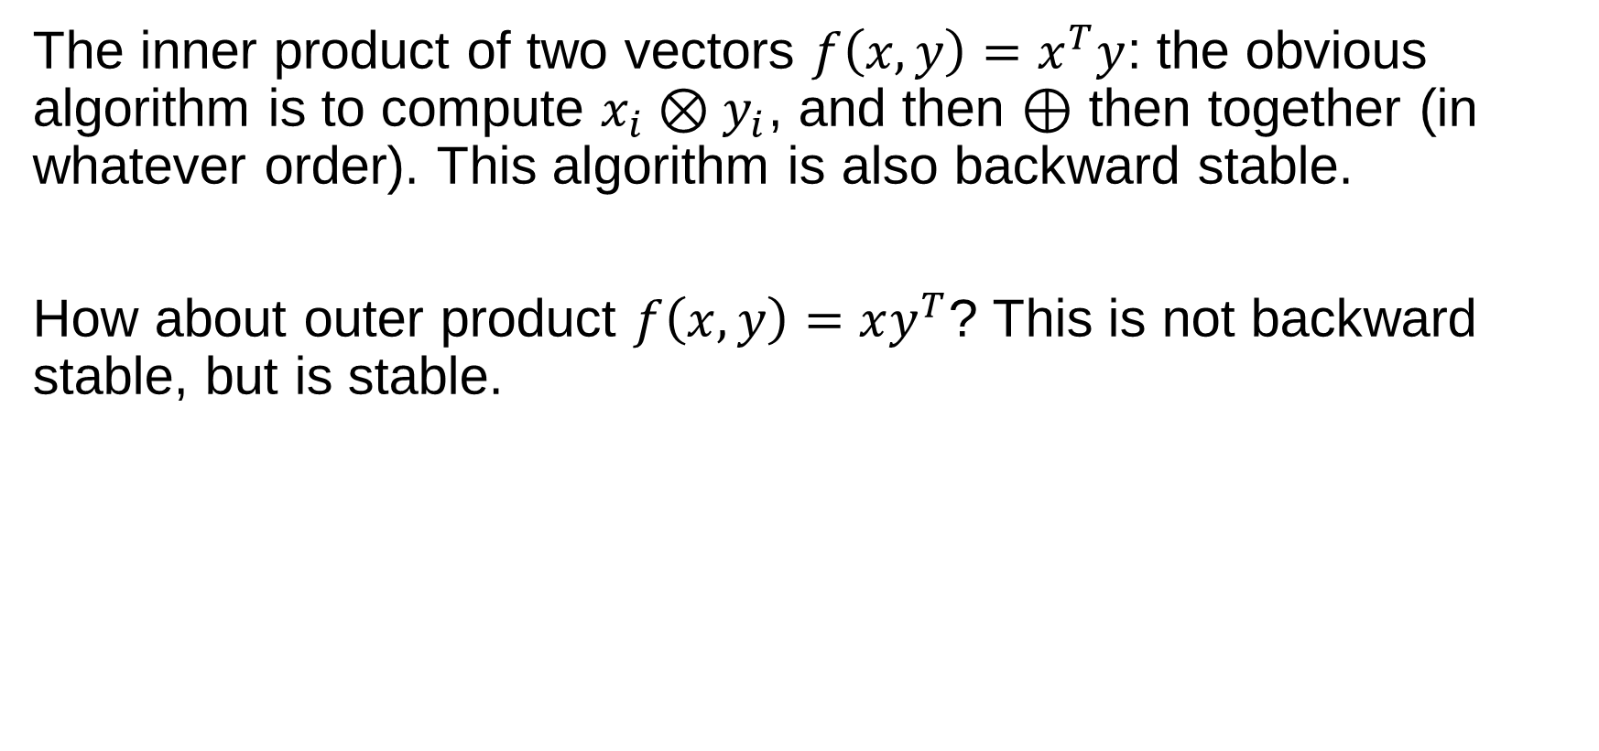
Examples
The inner product of two vectors $f\left(x,y\right)=x^{T}y$: the obvious algorithm is to compute $x_{i}⊗y_{i}$, and then $⊕$ then together (in whatever order). This algorithm is also backward stable.
How about outer product $f\left(x,y\right)=xy^{T}$? This is not backward stable, but is stable.

Slide 36
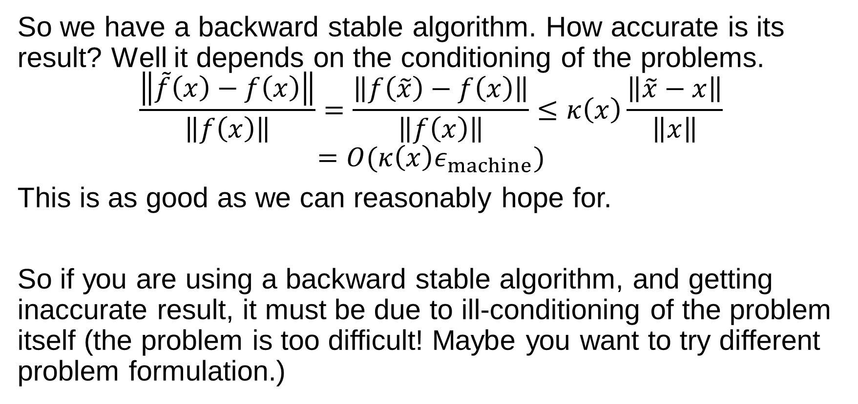
Accuracy of Backward Stable Algorithm
So we have a backward stable algorithm. How accurate is its result? Well it depends on the conditioning of the problems.
$$\frac{\left\|\tilde{f}\left(x\right)−f\left(x\right)\right\|}{\left\|f\left(x\right)\right\|}=\frac{\left\|f\left(\tilde{x}\right)−f\left(x\right)\right\|}{\left\|f\left(x\right)\right\|}≤κ\left(x\right)\frac{\left\|\tilde{x}−x\right\|}{\left\|x\right\|}$$
$$=O(κ\left(x\right)ε_{machine})$$
This is as good as we can reasonably hope for.
So if you are using a backward stable algorithm, and getting inaccurate result, it must be due to ill-conditioning of the problem itself (the problem is too difficult! Maybe you want to try different problem formulation.)

Slide 37
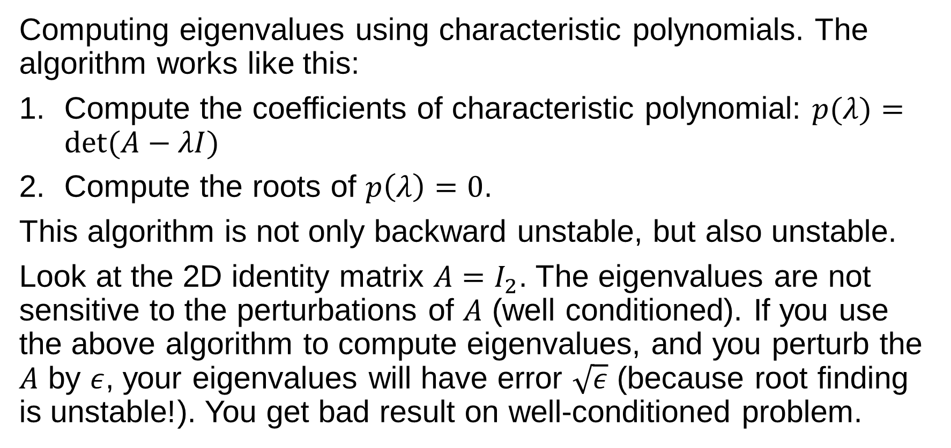
An unstable algorithm.
Computing eigenvalues using characteristic polynomials. The algorithm works like this:
Compute the coefficients of characteristic polynomial: $p(λ)=det(A−λI)$
Compute the roots of $p\left(λ\right)=0$.
This algorithm is not only backward unstable, but also unstable.
Look at the 2D identity matrix $A=I_{2}$. The eigenvalues are not sensitive to the perturbations of $A$ (well conditioned). If you use the above algorithm to compute eigenvalues, and you perturb the $A$ by $ε$, your eigenvalues will have error $\sqrt{ε}$ (because root finding is unstable!). You get bad result on well-conditioned problem.

Slide 38
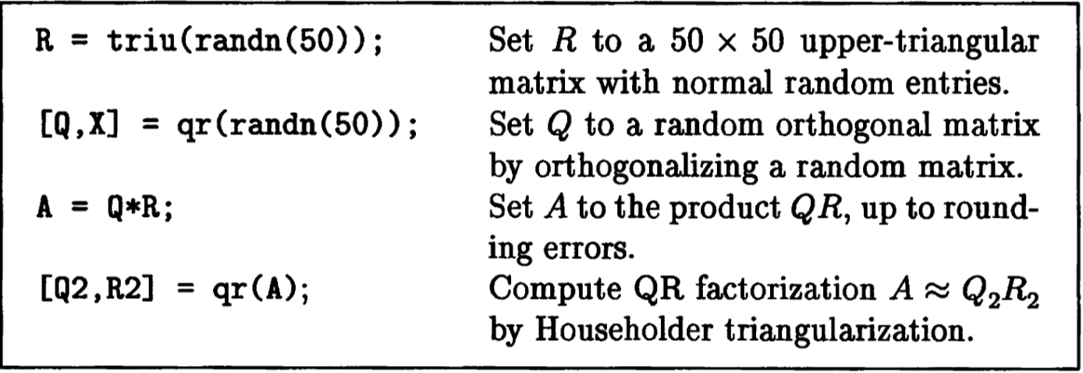
Stability of Householder QR
In the next slides we are going to experimentally explore the remarkable backward stability of Householder QR algorithm, and its use to solve linear systems.

Slide 39
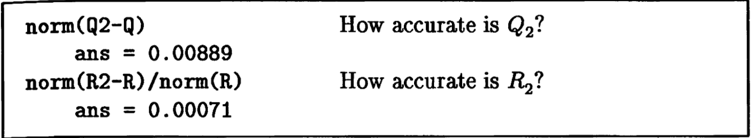
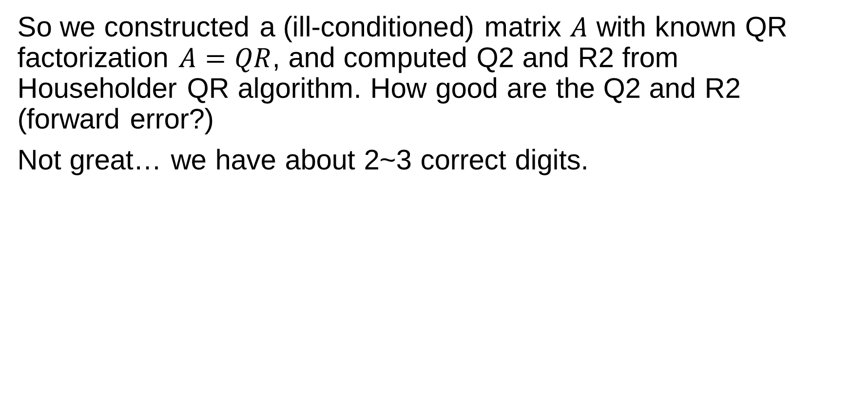
Householder QR Error
So we constructed a (ill-conditioned) matrix $A$ with known QR factorization $A=QR$, and computed Q2 and R2 from Householder QR algorithm. How good are the Q2 and R2 (forward error?)
Not great… we have about 2~3 correct digits.

Slide 40
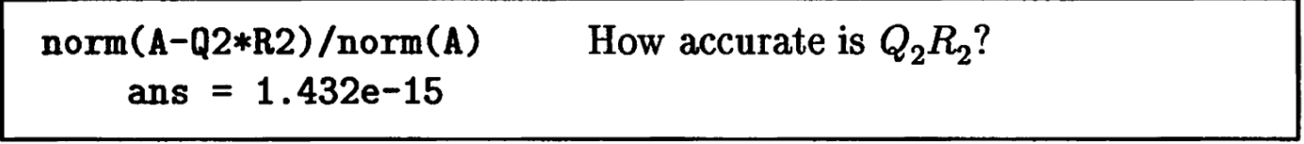
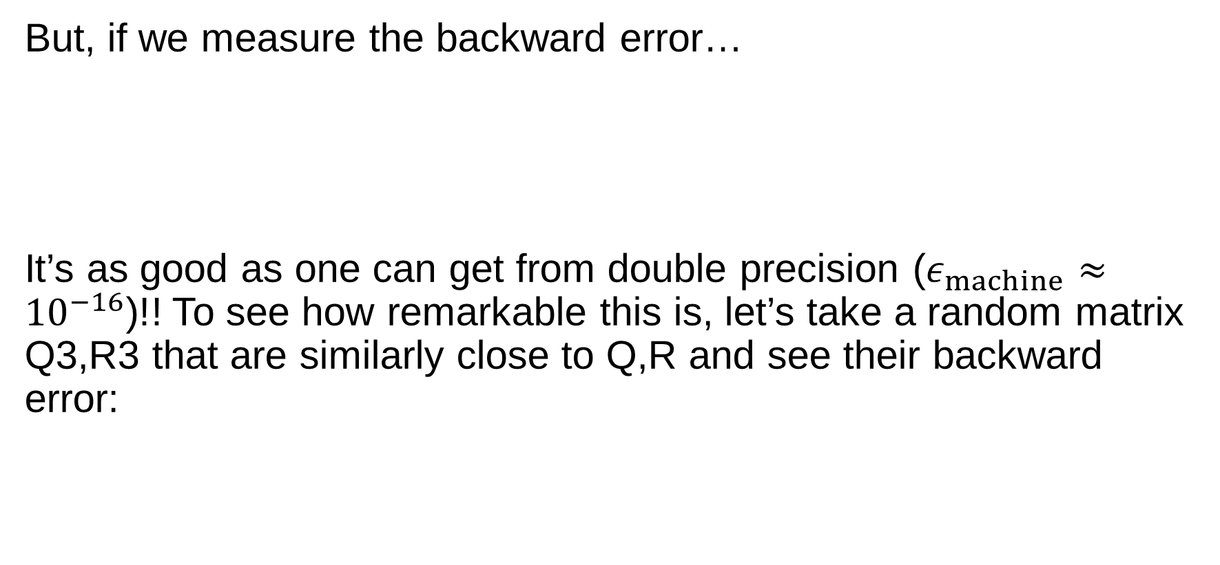
Backward Stability of HouseQR
But, if we measure the backward error…
It’s as good as one can get from double precision ($ε_{machine}≈{10}^{−16}$)!! To see how remarkable this is, let’s take a random matrix Q3,R3 that are similarly close to Q,R and see their backward error:

Slide 41
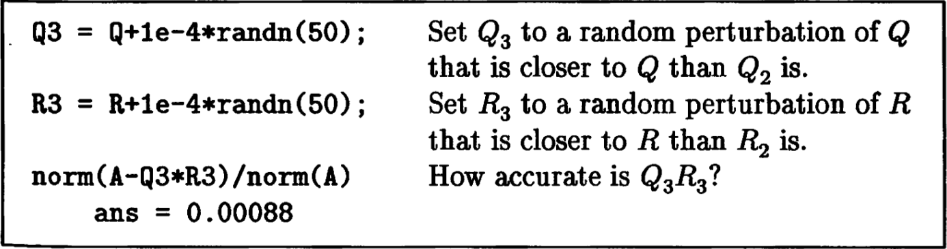
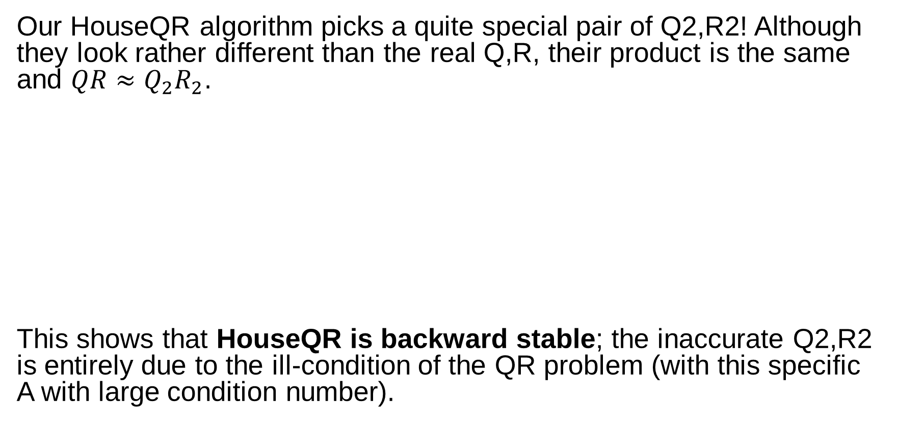
“Diabolically Correlation”
Our HouseQR algorithm picks a quite special pair of Q2,R2! Although they look rather different than the real Q,R, their product is the same and $QR≈Q_{2}R_{2}$.
This shows that HouseQR is backward stable; the inaccurate Q2,R2 is entirely due to the ill-condition of the QR problem (with this specific A with large condition number).

Slide 42
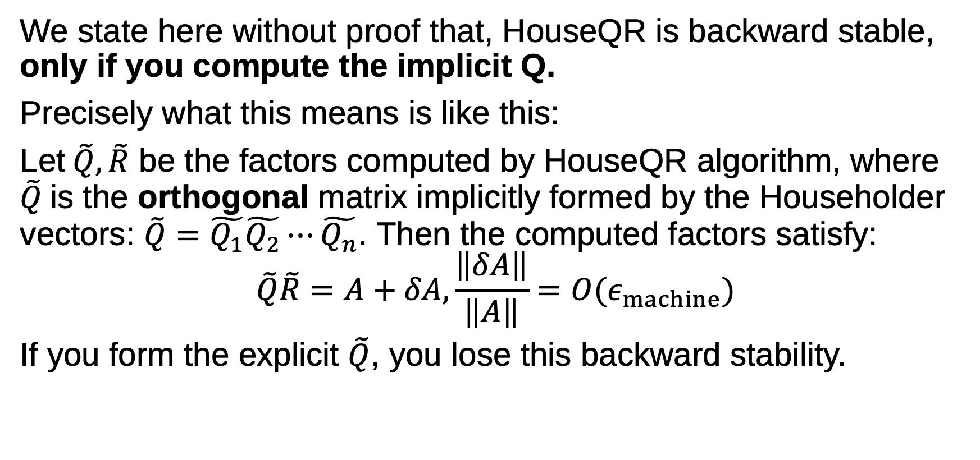
HouseQR backward stability
We state here without proof that, HouseQR is backward stable, only if you compute the implicit Q.
Precisely what this means is like this:
Let$\tilde{Q},\tilde{R}$ be the factors computed by HouseQR algorithm, where $\tilde{Q}$is the orthogonal matrix implicitly formed by the Householder vectors: $\tilde{Q}=\tilde{Q_{1}}\tilde{Q_{2}}⋯\tilde{Q_{n}}$. Then the computed factors satisfy:
$$\tilde{Q}\tilde{R}=A+δA, \frac{\left\|δA\right\|}{\left\|A\right\|}=O(ε_{machine})$$
If you form the explicit $\tilde{Q}$, you lose this backward stability.

Slide 43
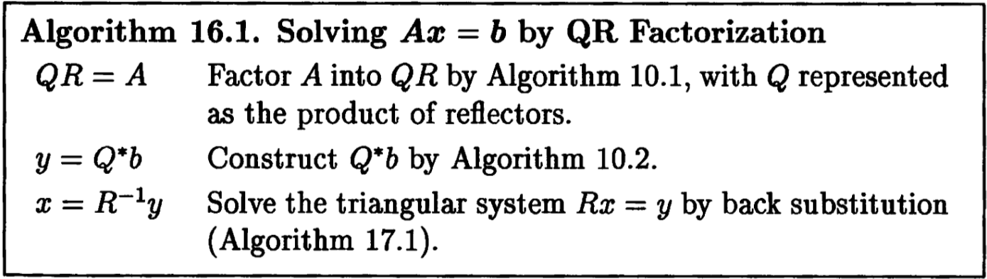
HouseQR as Linear Solver
In fact we can prove that HouseQR is backward stable as a theorem (which we don’t go into).
Now, because QR factorization is seldom the ends itself, but a means to some ends, we consider the algorithm to use HouseQR to solve (square) linear system:
Is it backward stable, assuming every step is backward stable?

Slide 44
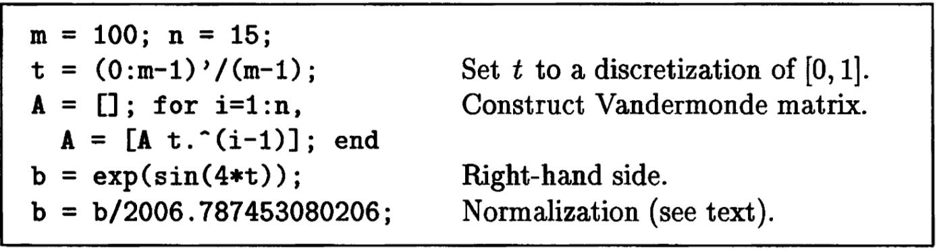
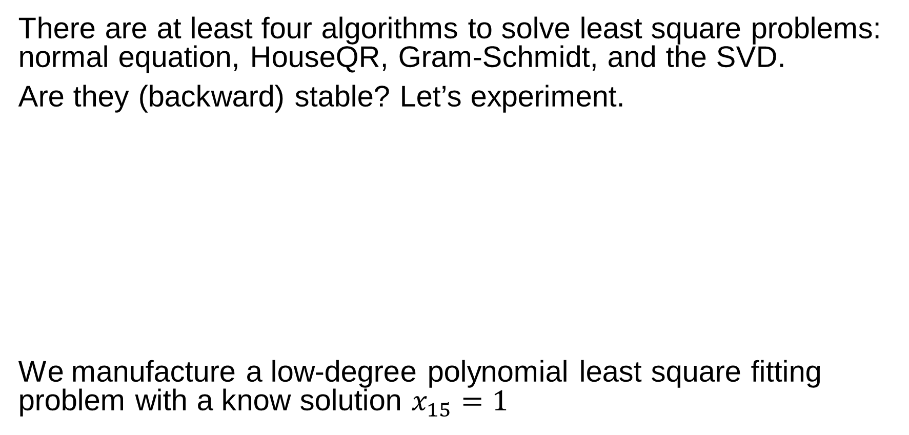
Stability of Least Square Algorithms
There are at least four algorithms to solve least square problems: normal equation, HouseQR, Gram-Schmidt, and the SVD.
Are they (backward) stable? Let’s experiment.
We manufacture a low-degree polynomial least square fitting problem with a know solution $x_{15}=1$

Slide 45
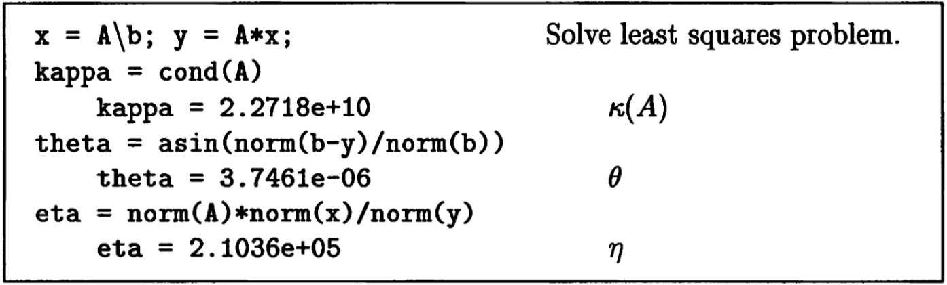
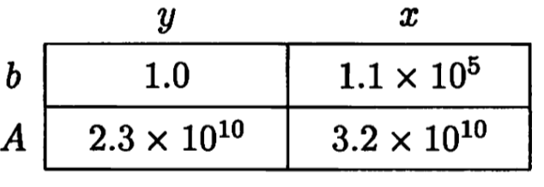
The conditions of this LLS

Slide 46
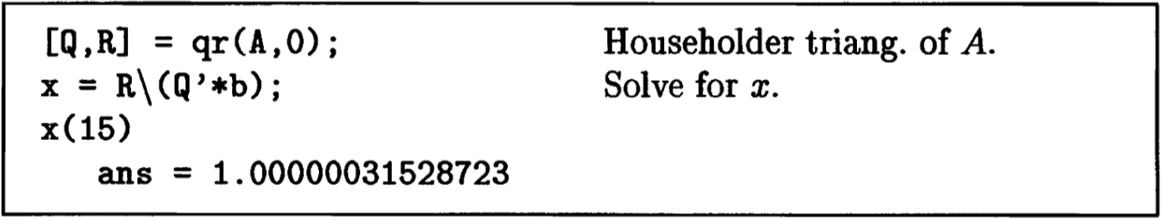
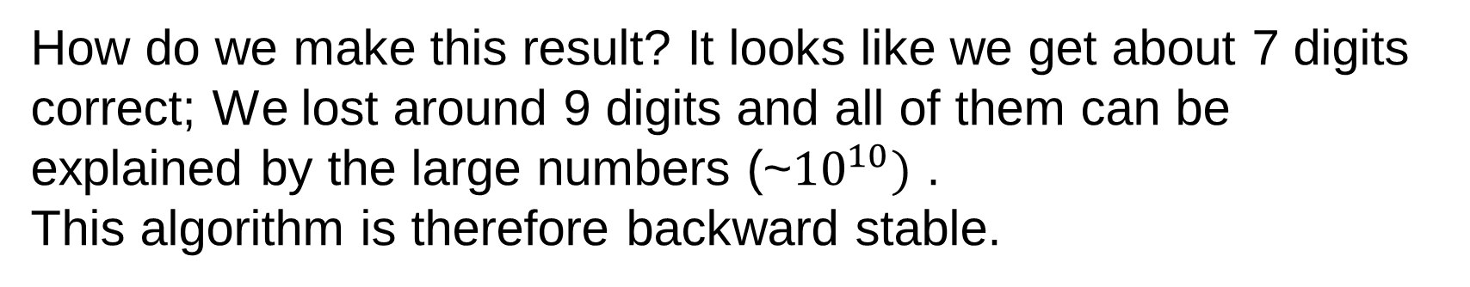
Householder Triangularization
How do we make this result? It looks like we get about 7 digits correct; We lost around 9 digits and all of them can be explained by the large numbers (~${10}^{10})$ .
This algorithm is therefore backward stable.

Slide 47
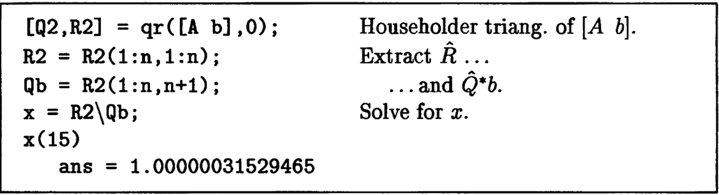
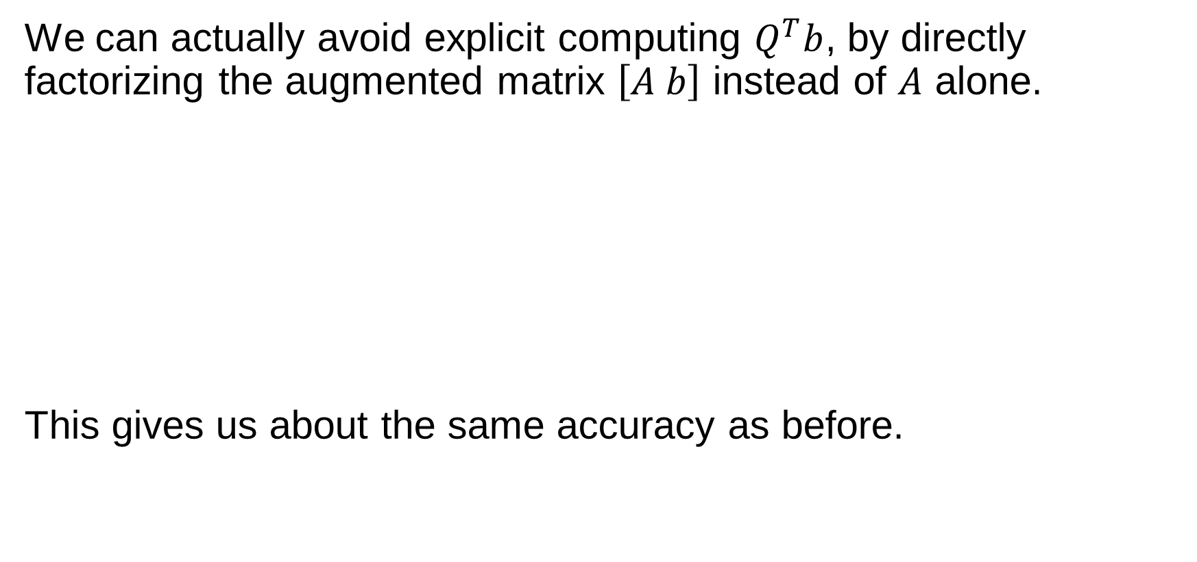
Factorize the Augmented System
We can actually avoid explicit computing $Q^{T}b$, by directly factorizing the augmented matrix $\left[A b\right]$ instead of $A$ alone.
This gives us about the same accuracy as before.

Slide 48

How does Matlab solve it
Not bad, actually a little bit more accurate than the last two algorithms.
The reason is that Matlab internally uses a column pivoted QR factorization that may work better for ill-conditioned problem.

Slide 49


Gram-Schmidt QR for LLS
How does the modified Gram-Schmidt QR fare in solving LLS?
Does not look good. This is unstable, because the $Q^{T}∗b$ step is unstable, because Q is not particularly orthogonal. (HouseQR is not affected because if $Q$ is near orthogonal, hence stability)
But mgs() is backward stable, so if we can avoid the second step…
How about factorizing the augmented system $[A b]$?

Slide 50

MGS on Augmented System
As good as one can get. This algorithm is backward stable, because all the steps are backward stable.

Slide 51


Normal Equations
The obvious and simplest way to solve LLS: $A^{T}Ax=A^{T}b$
This is way off… not a single correct digit. What happened?
More confusingly, every step looks “backward stable”! (The linear solve is via Cholesky factorization which is backward stable).
So the whole algorithm is backward stable; the problem could only be that we changed the condition number.
What is the condition number of $A^{T}A$? (hint, $κ{\left(A\right)}^{2}$)

Slide 52


One more… the SVD
It’s time for our heaviest hammer SVD to work.
This is the most accurate, about 3x more than Matlab \.
If the matrix $A$ does not have full rank, then it’s a completely different problem because we no longer have a unique solution. In that case we must determine the numerical rank. The only stable algorithm is SVD based. Alternatively column pivoted QR may sometimes be usable.

